Slide 1
for the life of your car
January 21, 2013 Presented by User Experience Sears

Slide 2
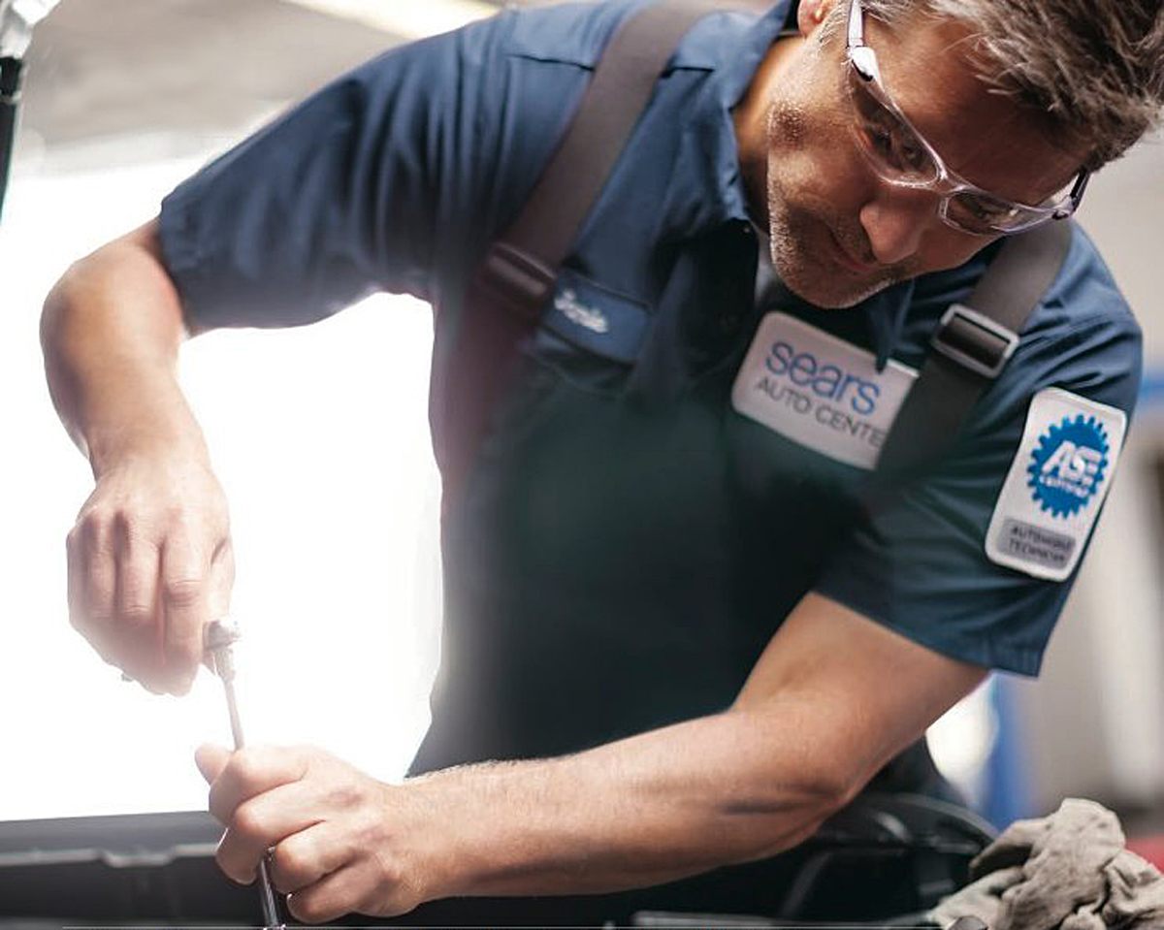
strengths

Slide 3
• Sears Auto Services has kept cars running smoothly and car owners happy for generations.
• In fact, of the many things Sears does well, Auto Services are right at the top of that list.
• Sears has manufactured and sold cars since the turn of the century so you can say we’ve been around as long as cars themselves.

Slide 4
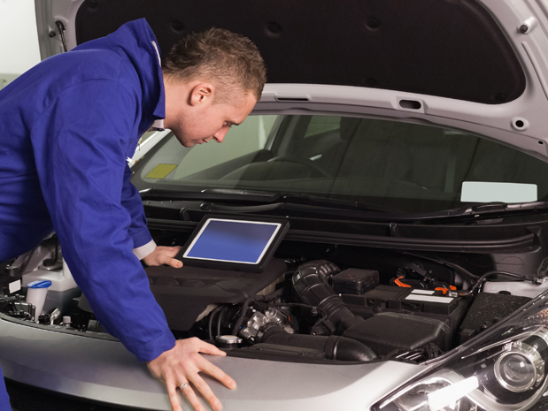
challenges

Slide 5
• Sears, with 780 Auto Center locations nationwide, has an established physical presence that is more than competitive with (and often tops) organizations such as Pep Boys and Wal-Mart.
• However, the Sears digital presence does not reflect this leadership position.
• The services featured on sears.com aren’t detailed or differentiated enough to be beneficial to customers.

Slide 6
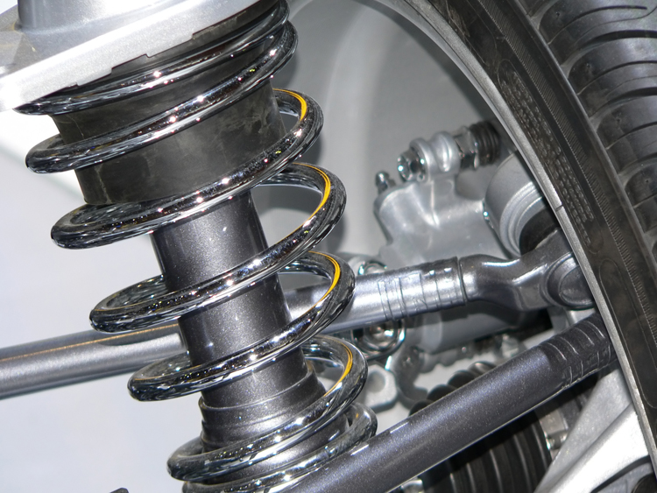
insights

Slide 7
• Current user experience design — we recommend making the content more helpful and benefit-oriented; the hierarchy more in synch with customer behavior and business priorities such as long-term maintenance relationships; and the navigation more intuitive.
• Current visual design — we recommend making the design more attention grabbing and reflective of the new design patterns used throughout the site; we also realized that Auto Services needs a look/feel that will make it stand out as a leader.
• Current content – we recommend fleshing out current modules and strongly recommend putting a strategy in place that leads to solid editorial schedules, refreshed and benefit-driven content.

Slide 8
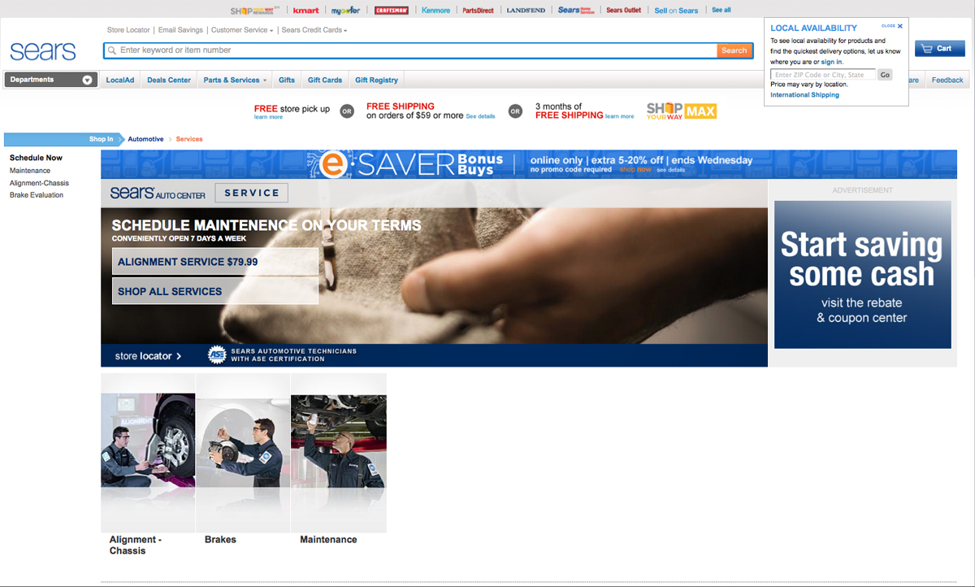
before

Slide 9
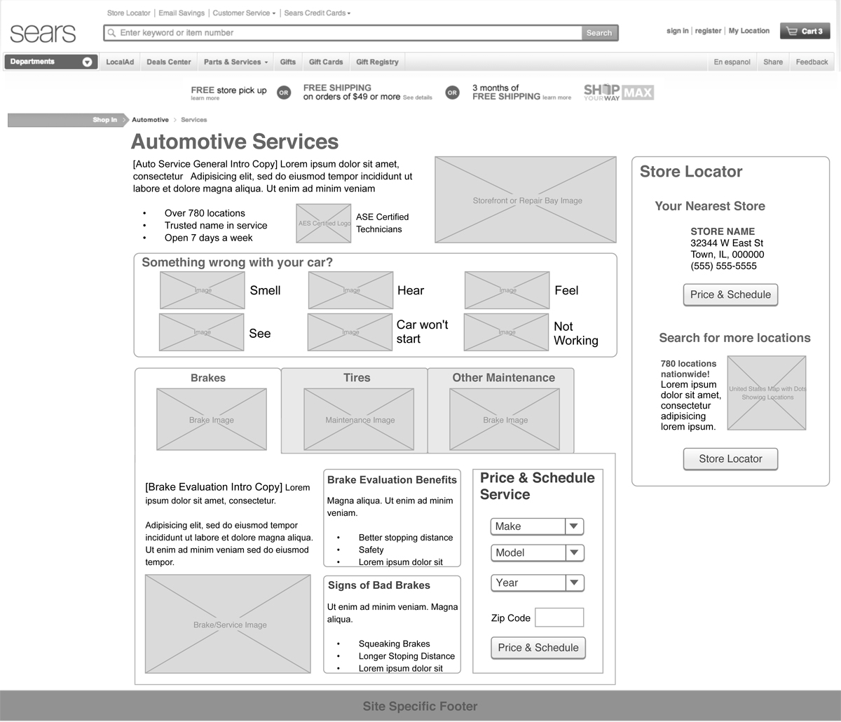
sketch needs work

Slide 10
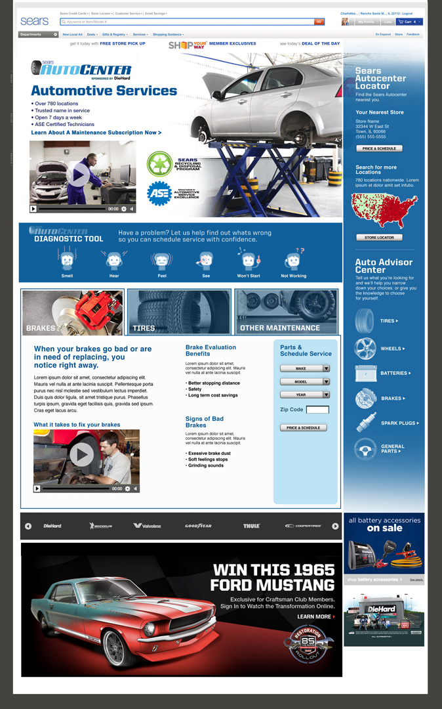
new comp
See PDF to view full version

Slide 11
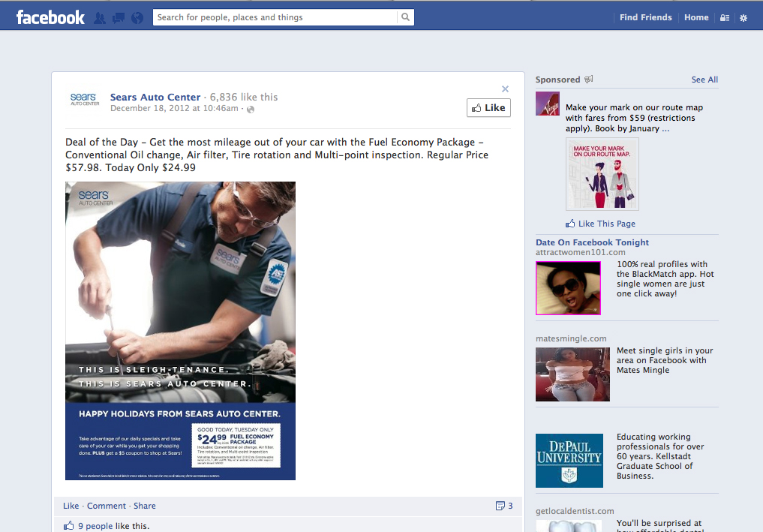
How to get to page: Vertical, website banner ads, external ads, facebook/twitter, in-store promotions, mobile
portals

Slide 12
future thinking

Slide 13
We want to gauge your interest in these blue-sky, good for your business ideas. All of them, to some extent, will require partnering with other teams such as engineering. We’ll have to look at time/costs.
Fleet/Family plan – bring in all household autos for repair or regular maintenance. Offer discounts, SYW rewards, etc. Think about Layaway to cover costs. This paves the way for generations of customer care and supports “for the life of your car” mindset. Instead of a mobile phone family plan this is an auto family plan.
Mobile Point of Sale – sign up for offer that you can use in a Sears store while car is being serviced. When your car is ready, or the tech has a diagnosis, you receive a text (synch up with current TPOS team offering).
My Glovebox – a mobile enabled maintenance scheduler that keeps you on track and if we bring back pre-pay, customers get a volume discount. Other mobile ideas: diagnostic tips and photos you can take and send to an Auto Center. Schedule, history, find a Center, etc. can be part of mobile deliverables.

Slide 14
Content – the best we have sourced through MML and used in modules that are branded for Auto Services. Editorial schedules can be set up as well and original content produced. We can also leverage our relationship with Consumer Reports to get relevant, SEO-friendly content.
Choose your mechanic – consider partnering with TimeTrade to accept data needed to schedule online with a specific technician. A similar model is being worked on for Home Services. As an add-on: Car Care Clinics for face-to-face interaction. These ideas reinforced by actual Auto Center managers on Pebble.
Social — encourage reviews and drive to SYW. Social marketing: offers via Facebook and Twitter.
Go green — focus on the benefits of having Auto Services take care of oil, parts scrapping/recycling, etc. If possible, mimic the positive message Home Appliances used with Energy Star campaign.

Slide 15
• Agree on approach/set goals
• Talk timing/costs — leading to a signed Statement of Work
• Prioritize work and commit to planning for 2013
• Execute, measure, adjust
• Meet goals
next steps

